Slide 1
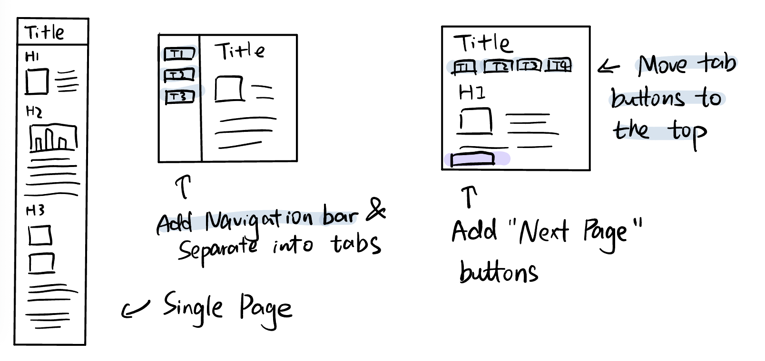
Overall Layout
Single Page: slow loading speed & hard to navigate
Navigation bar on the left: Leave narrow spaces for the contents

Slide 2
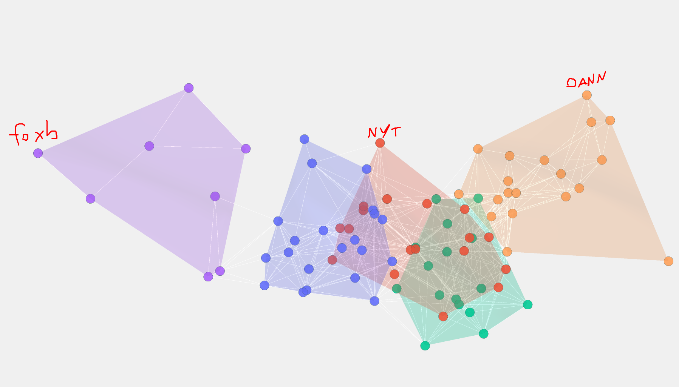
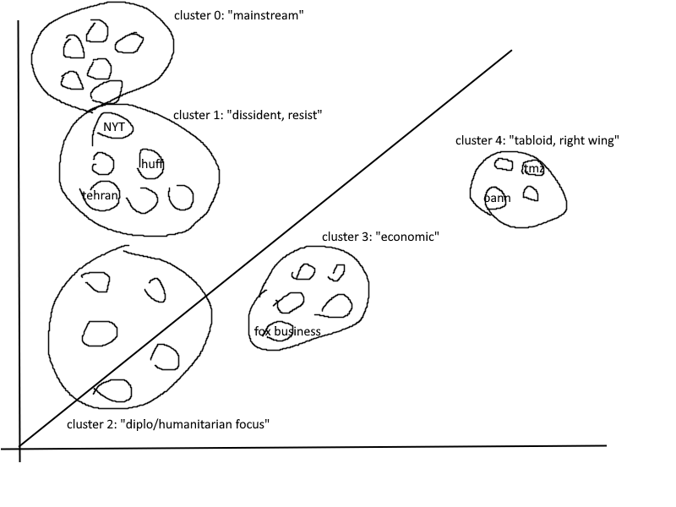
Network for Media Clusters

Slide 3
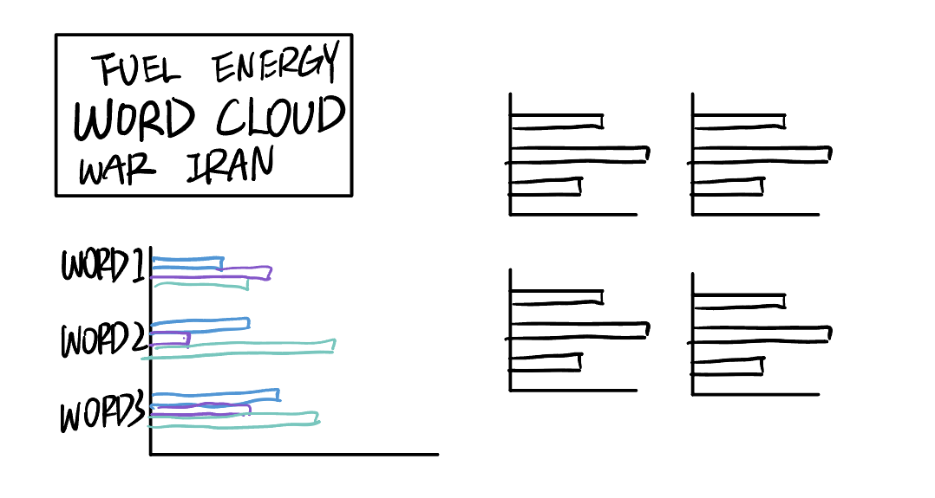
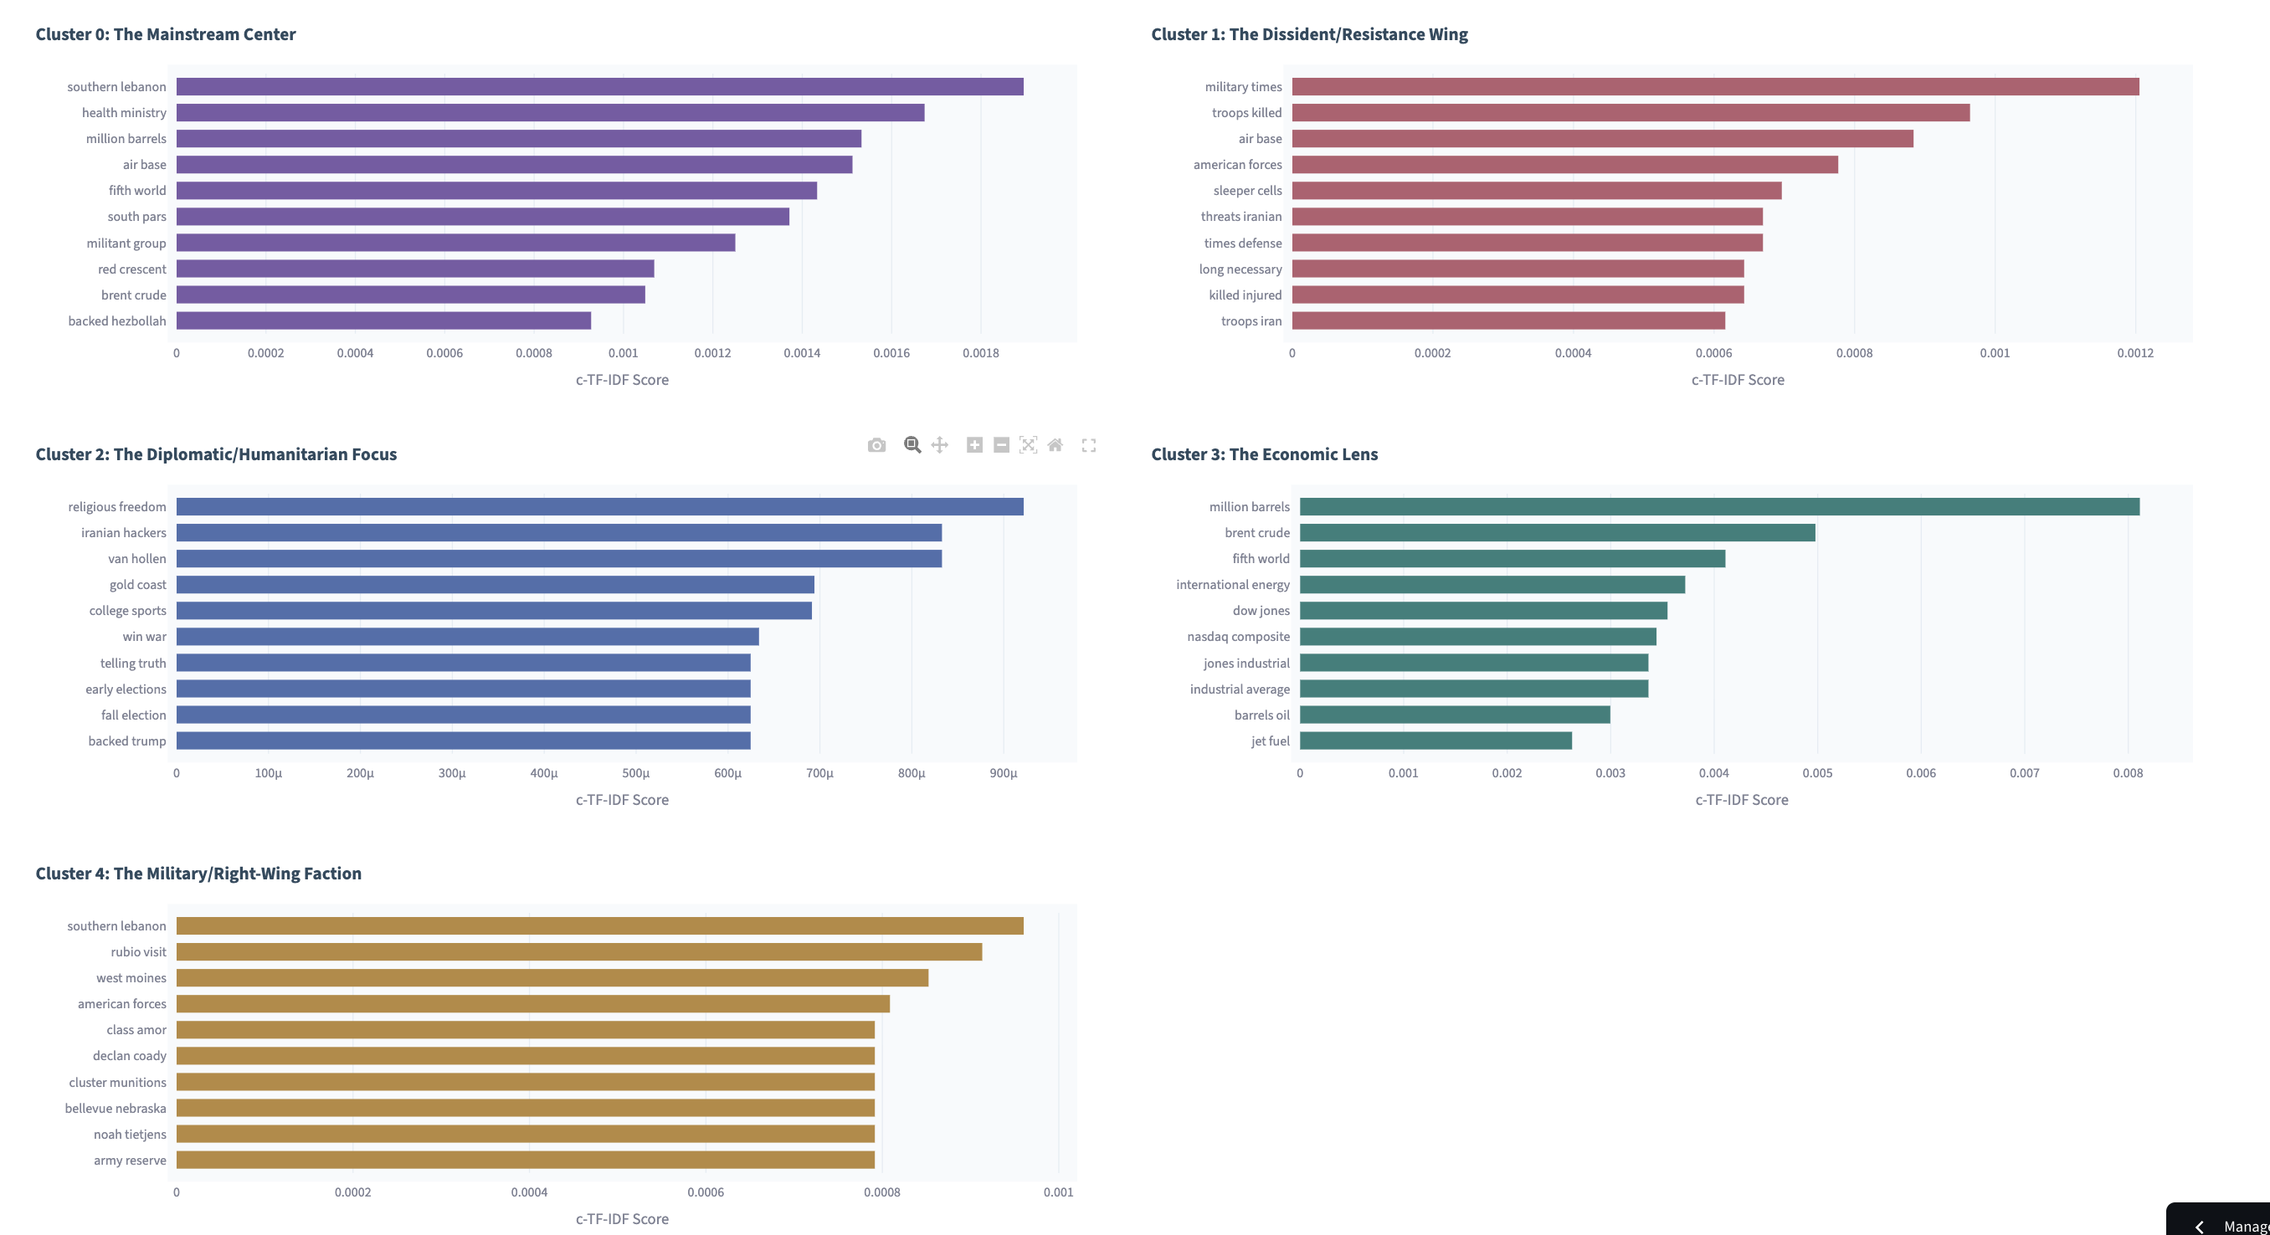
Unique Phrases of media clusters
Graph Choices:
Word cloud: visually attractive, but hard to compare.
Grouped bar chart: too crowded.
Faceted bar charts: better readibility and easier to compare.
Phrase Choice:
At first, we tried to create plots with unique words, but there are too many meaningless words, so we switched to bigrams to make results more interpretable.

Slide 4
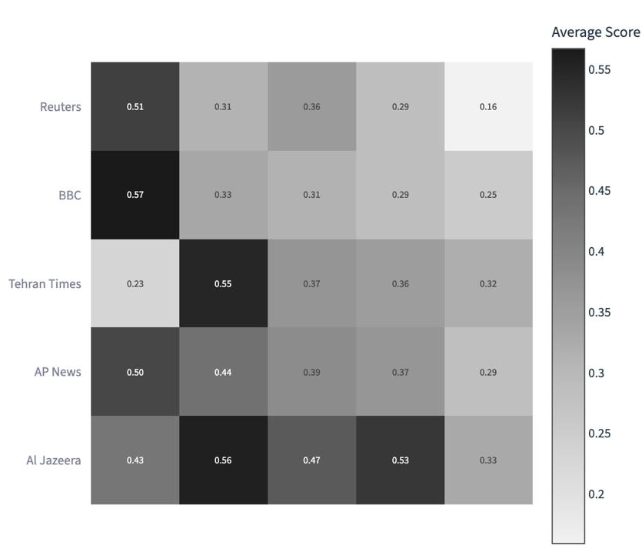
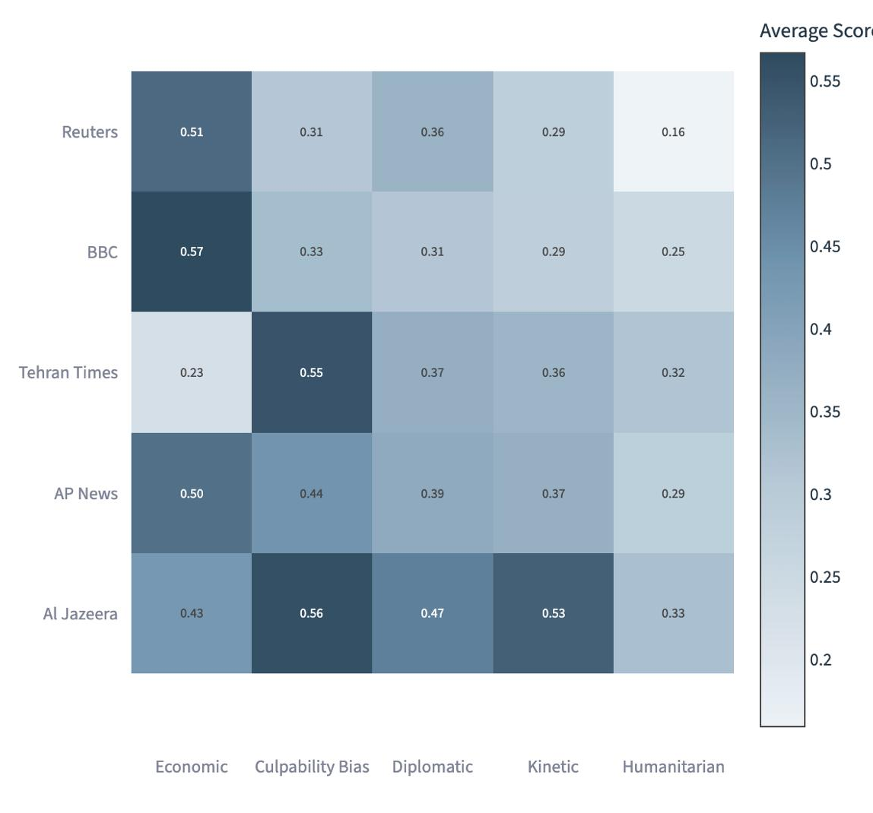
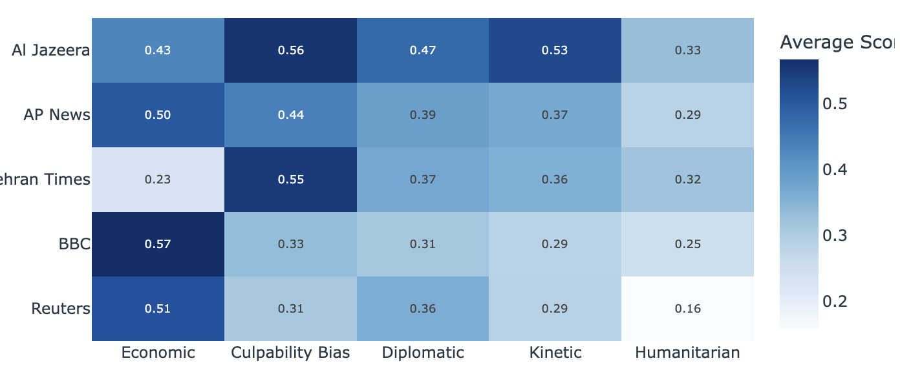
Heatmap: framing scores across 5 outlets
Color Scheme Choice:
Blues scheme: too visually strong compared to other visualizations.
Greys scheme: Less distracting, but felt strange.
Muted Blues: more consistent with the overall visual style.
Layout:
rectangular cells → square cells: feel more balanced and easier to scan.
Extended the color legend to make the score range clearer.

